Slide 1






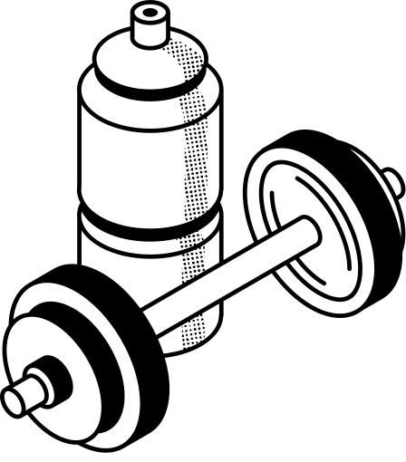



Github Link: https://github.com/Saadet2805/Fuzzy-Exercise-Assistant.git
FUZZY EXERCISE ASSISTANT
MERCAN ESEN
SAADET YILMAZ

Slide 2
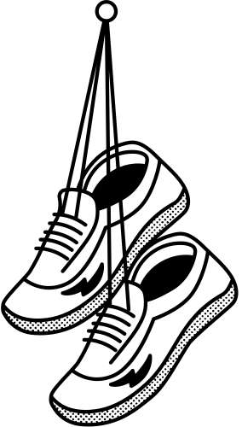
WHY DID WE CHOOSE THIS TOPIC?

Slide 3
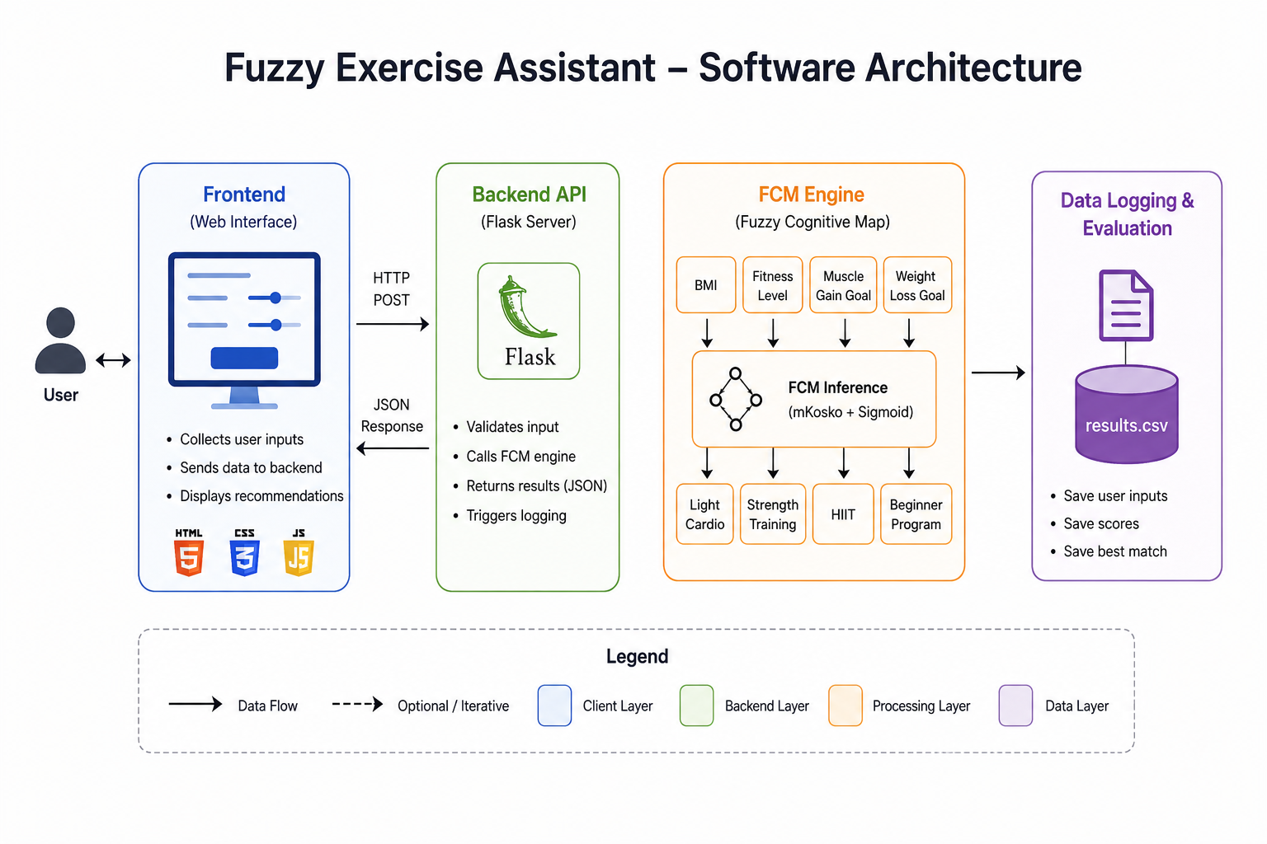
Software Architecture

Slide 4
What the Assistant does
The assistant collects four inputs, runs them through a Fuzzy Cognitive Map, and returns a scored, ranked list of exercise categories. Everything happens through a clean web interface , no spreadsheets, no technical knowledge needed.

Slide 5
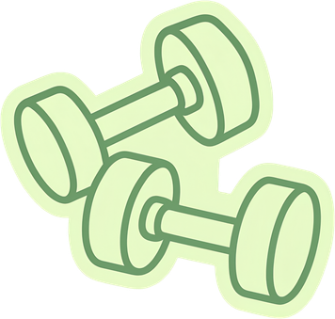



INPUTS
FITNESS LEVEL
MUSCLE GAIN
WEIGHT LOSS
BMI
User enters their BMI value; the interface converts it to a 0–1 scale. 1 = very high BMI0 = very low BMI
How experienced the user is with exercise, from complete beginner to professional level. 0 = no experience1 = professional / expert
How strongly the user wants to gain muscle mass as a goal. 0 = not a goal1 = primary goal
How strongly the user wants to lose weight as a goal. 0 = not a goal1 = primary goal

Slide 6
Low-intensity cardiovascular exercise such as walking, light cycling, or swimming at a relaxed pace. Particularly relevant for users with high BMI or those new to exercise, where joint stress must be minimised.
Light Cardio
TYPES OF TRAINING: WHICH ONE IS FOR YOU?
Resistance and weight training exercises aimed at building muscle and increasing metabolic rate. Central recommendation for users with a muscle gain goal; also supports weight maintenance.
Strength
High-Intensity Interval Training — short bursts of intense effort alternated with rest periods. Most suitable for users with a good fitness base. Not recommended for high BMI or complete beginners due to injury and cardiovascular risk.
The system generates recommendations for four different types of exercises. Each output is a value between 0 and 1. (0-irrelevant, 1-strongly recommended) The outputs are not mutually exclusive; a user can receive high scores for multiple types at the same time, which means the system is recommending a combination.
HIIT
General beginner programs using bodyweight movements and foundational exercise patterns. Relevant for users with little or no exercise experience regardless of their specific goals. Does not correlate with muscle gain or weight loss goals directly.
Beginner

Slide 7
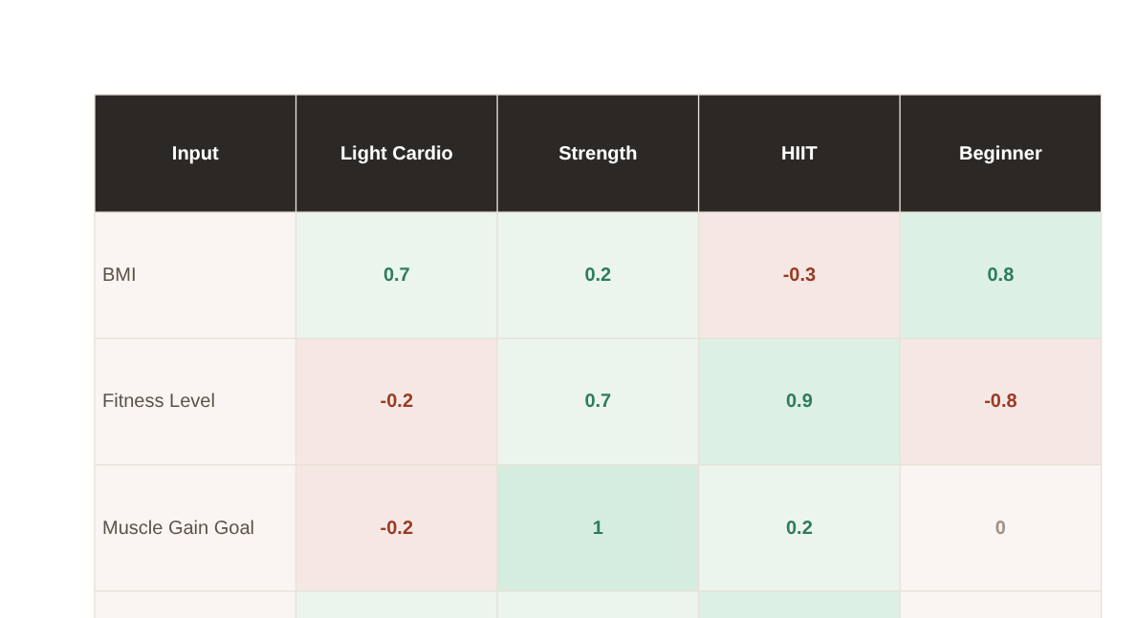




How Inputs Shape Recommendations

Slide 8



ASSIGNING WEIGHTS
HEALTH PROBLEMS
Reviewing scientific articles to gorund our weights.
Warning sign
LIMITATIONS
EVALUATION METHOD
INTERFACE
Expert Evaluation
Simple HTML page with a form
User Evaluation

Slide 9
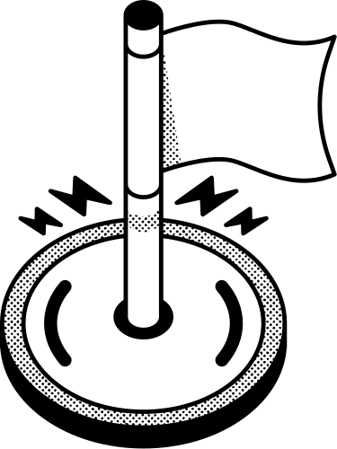





FEEDBACK
"Starting at 1 is misleading — I had no way to say zero
priority."
"More specific exercises could be included."
"Add pictures or videos of the exercises."
"I would want to enter body fat & medical conditions."
"Easy to use and nice to look at."

Slide 10
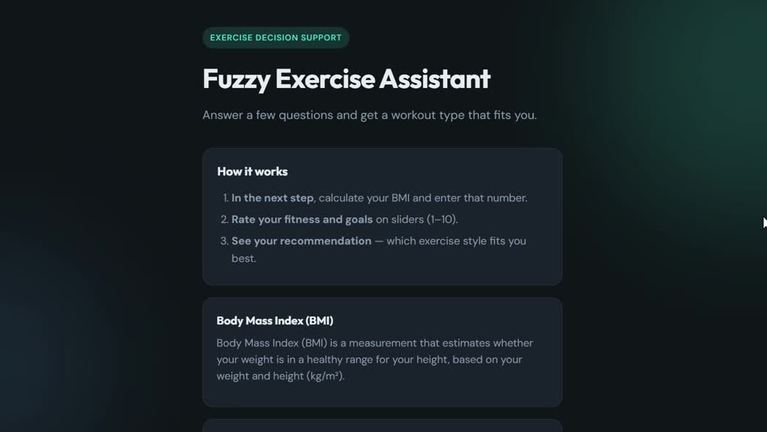

Slide 11
THANK YOU VERY MUCH!

